Slide 1


Property Scaling Relations for Nonpolar Hydrocarbons
Sai R. Panuganti¹, Francisco M. Vargas^{1, 2},
Walter G. Chapman¹
¹ Chemical and Biomolecular Engineering Department, Rice University, Houston, USA
² Department of Chemical Engineering, The Petroleum Institute,
Abu Dhabi, UAE
February, 2013

Slide 2
Outline
One-Third Rule
Electronic polarizability
Dielectric constant
Critical temperature and pressure
Surface tension
Conclusion

Slide 3
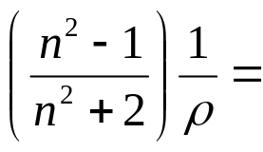
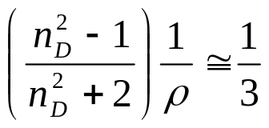
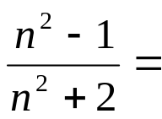
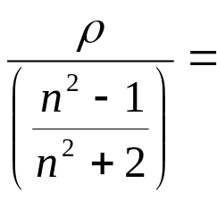
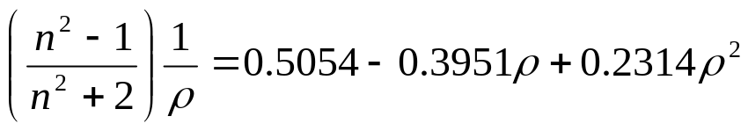
One-Third Rule
Specific Refractivity: independent of the temperature and pressure
n, refractive index and ρ, mass density (g/cc)
For nonpolar hydrocarbons and their mixtures
Constant
True volume of the molecules in unit volume
True density of the molecules
But strictly speaking, it is a function of the mass density and can be expressed as
L-L Expansion

Slide 4


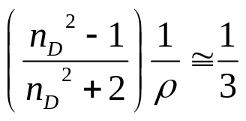
One-Third Rule
Increase
Temperature
Volume occupied by molecules without considering space between molecules
V increases, ρ decreases
n increases
For nonpolar hydrocarbons
Vargas FM, Chapman WG; Fluid Phase Equilibria, 2010; 290:103-108

Slide 5
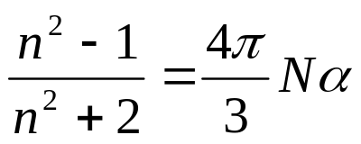
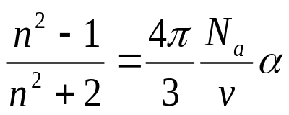
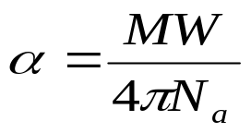
Electronic Polarizability
Lorentz–Lorenz equation:
where, N – Number of molecules per unit volume
α – Polarizability
Refractive index and Polarizability are independent of the amount of material
where, N_{a} – Avogadro number
v – Molar Volume (v = MW/ρ)
With the help of One-Third Rule the above expression simplifies as
The above equation is independent of the state of the substance and its polarizability can be computed by just knowing the molecular weight

Slide 6
Predicted Polarizability
Using One-Third Rule
Average absolute deviation is 4.16 %
Using Lorentz-Lorenz Expansion
Average absolute deviation is 2.72 %
Data shown is for 80 different nonpolar
hydrocarbons belonging to different homologues series

Slide 7
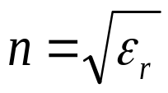

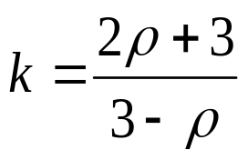
Dielectric Constant
It is well established that for weakly magnetic materials
ε_{r} , relative permitivity
For low-loss materials like nonpolar hydrocarbons,
k, dielectric constant
Substituting dielectric constant in the One-Third Rule and solving for dielectric constant
The dielectric constant expression can handle operational variations in temperature and pressure
It is independent of the knowledge of individual constituents of a mixture or the composition allowing the use for complex fluids such as crude oils and polydisperse polymers

Slide 8
Predicted Dielectric Constant
Using One-Third Rule
Average absolute deviation is 1.98 %
Using Lorentz-Lorenz Expansion
Average absolute deviation is 1.0 %
Data shown is for 260 nonpolar hydrocarbons, including polymers, mixtures with varying temperatures and pressures
Panuganti SR, Vargas FM, Chapman WG; IEEE Transactions on Dielectrics and Electrical Insulation, 2013; Submitted

Slide 9
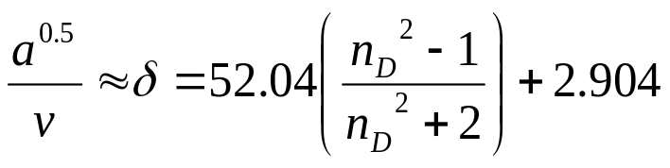
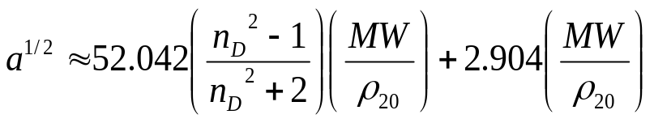

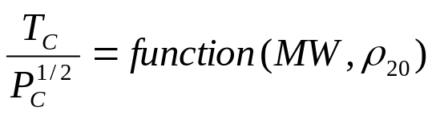
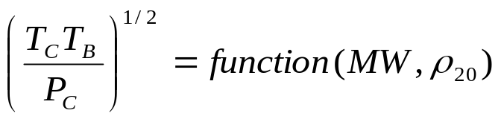
Critical Temperature and Pressure
From literature we have,
Thus, the following expression holds good
Applying One-Third Rule
also
Hildebrand and Scott
Buckley et al.
Let,
Hildebrand JH, Scott RL; The Solubility of Nonelectrolytes, 1950
Buckley et al; Petroleum Science and Technology, 1998; 16:251-285

Slide 10
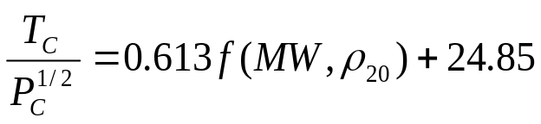
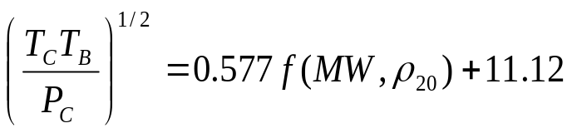
Critical Temperature and Pressure
Panuganti SR, Vargas FM, Chapman WG; Industrial and Engineering Chemistry Research, 2013; Accepted

Slide 11
Predicting Critical Properties
Average absolute deviation
is 2.2 %
Average absolute deviation
is 4.5 %
Data shown is for 80 different nonpolar
hydrocarbons belonging to different homologues series. The applicability to mixtures is limited to nonpolar hydrocarbons composed of similar sized molecules

Slide 12
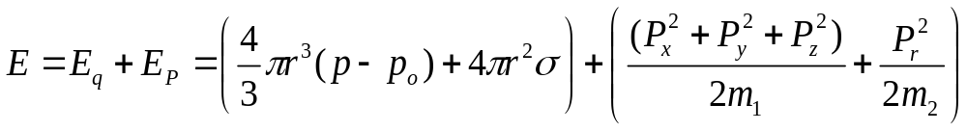
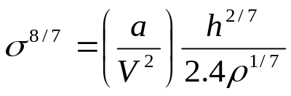
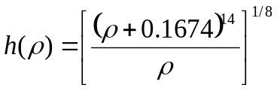


Surface Tension from Hole Theory
Volume of hole = Volume of liquid - Volume of solid
Heat of fusion = Energy required for the formation of all the holes
Solving the Schrodinger wave equation for a hole in a liquid,
Using the correlation of a/v² from the previous section, at a given temperature we have
For example at 20ºC we have
where,
Furth R; Proc. Phys. Soc., 1940; 52:768-769
Auluck FC, Rai RN; Journal of Chemical Physics, 1944; 12:321-322

Slide 13

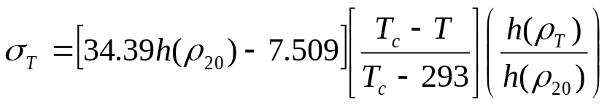
Predicted Surface Tension
The practical application of equation can improved further by incorporating the temperature variation of surface tension
With reference temperature as 20°C, surface tension at any other temperature can be calculated as
The parameter of critical temperature can be eliminated using the equation obtained in the critical properties section.
Average absolute deviation is 1.8 %

Slide 14
Conclusion
 | Input Parameters
Property | Density | MW | Boiling Point | Function of Temperature | Mixtures
Critical Temperature | Y | Y | Y | - | Y
Critical Pressure | Y | Y | Y | - | Y
Surface Tension | Y | Y | Y | Y | N
Electronic Polarizability | N | Y | N | - | -
Dielectric Constant | Y | N | N | Y | Y
Polarizability of an asphaltene molecule of molecular weight 750 g/mol will be 99.16x10⁻²⁴ cc
Polydispere asphaltene system with density between 1.1 to 1.2 g/cc at ambient conditions will have a dielectric constant between 2.737 and 3
Panuganti SR, Vargas FM, Chapman WG; IEEE Transactions on Dielectrics and Electrical Insulation, 2013; Submitted
Panuganti SR, Vargas FM, Chapman WG; Industrial and Engineering Chemistry Research, 2013; Accepted

